Slide 1
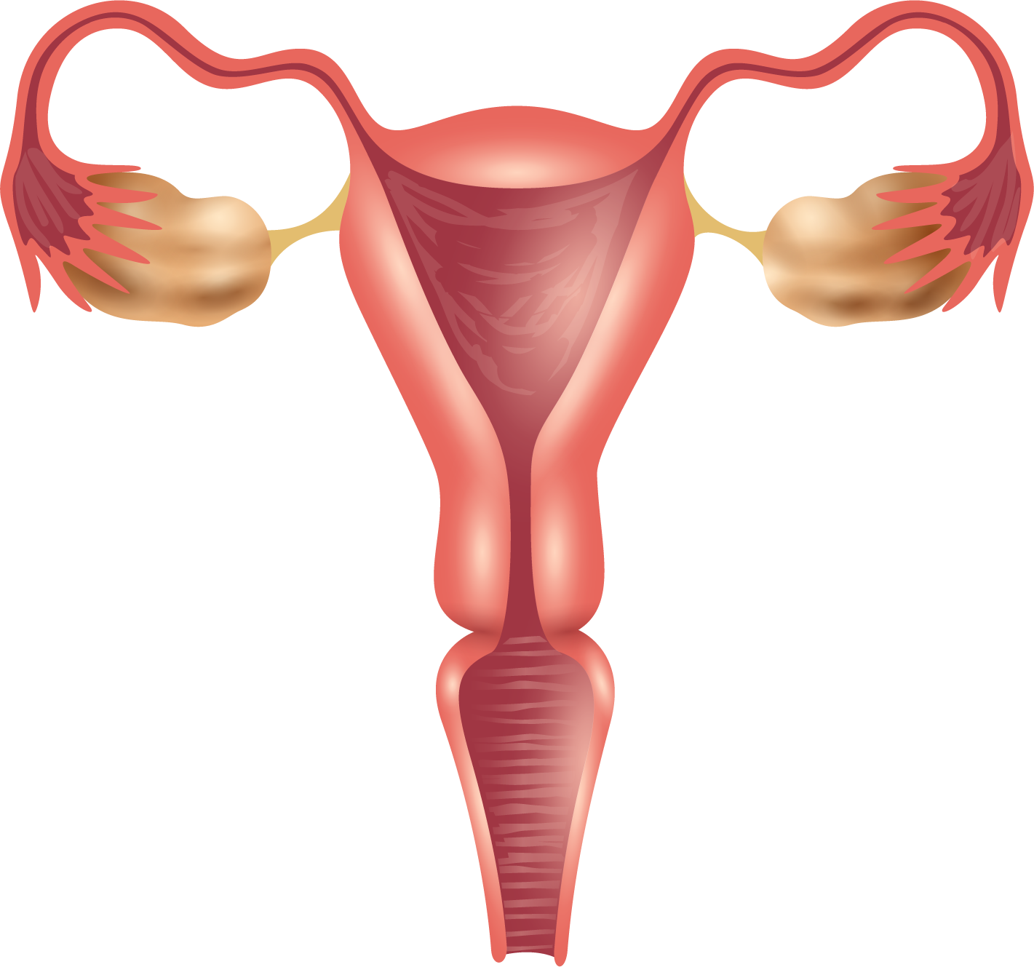
POLYCYSTIC OVARY SYNDROME (PCOS)
PREDICTION OF
GROUP - 6

Slide 2





Our Team
SHANKAR LOHAR
TEJAS JOHARAPURKAR
PARINATI GAUR
SHUBHAM HARESH TEJANI
20BAI10148
20BAI10149
20BAI10152
KULDEEP MEHTA
HARSH SEN
IPSITA MAITY
20BAI10175
20BAI10154
20BAI10159

Slide 3
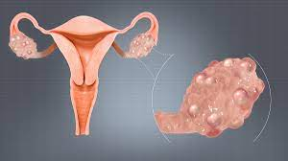
ABOUT THE DISEASE
01
Polycystic ovary syndrome (PCOS) is a condition in which the ovaries produce an abnormal amount of androgens, male sex hormones that are usually present in women in small amounts. The name polycystic ovary syndrome describes the numerous small cysts (fluid-filled sacs) that form in the ovaries.

Slide 4
POLYCYSTIC OVARY DIAGNOSIS
NORMAL OVARY
POLYCYSTIC OVARY

Slide 5
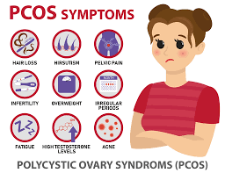
SYMPTOMS
• Missed periods, irregular periods, or very light periods.
• Ovaries that are large or have many cysts.
• Excess body hair, including the chest, stomach, and back (hirsutism)
• Weight gain, especially around the belly (abdomen)
• Acne or oily skin.
• Male-pattern baldness or thinning hair.
• Infertility

Slide 6
LOADING THE DATASET
ABOUT OUR DATA
This dataset contains all physical and clinical parameters to determine PCOS and infertility related issues. There are a total of 44 parameters.
This data is collected from 10 different hospitals across Kerala, India.
The unit used is feet to cm
Blood pressure entered as systolic and diastolic separately
RBS means Random glucose test
Beta-HCG cases are mentioned as Case I and II
Blood Group indications: A+ = 11, A- = 12, B+ = 13, B- = 14, O+ =15, O- = 16, AB+ =17,
AB- = 18

Slide 7
DATA PREPROCESSING
Steps involved in Data Preprocessing:
Merging the two files that are sorted into two based on patients with infertility and without infertility
Dropping the repeated features
Encoding categorical variables (dtype objects)
Dealing with missing values

Slide 8
CONCLUSIONS
01
Some numeric data are saved as strings.
02
There are some missing values.
Namely, Marriage Status (Yrs) & Fast food (Y/N)

Slide 9
EDA
Steps involved in EDA:
Feature selection based on the correlation factor
Patterns Of Length Of The Menstrual Cycle
Patterns Of BMI
Patterns Of Irregularity In Mensuration
Number of Follicles
Some Miscellaneous EDA

Slide 10
MODEL BUILDING
Steps involved in Model Building:
Assigning values to features as X and target as y
Split test and training sets
Fitting a vanilla model as the base Random Forest model
Hyperparameter tuning using GridSearch CV
Fitting the final model
Evaluating the confusion matrix
Evaluating the classification report

Slide 11
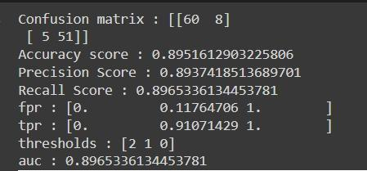
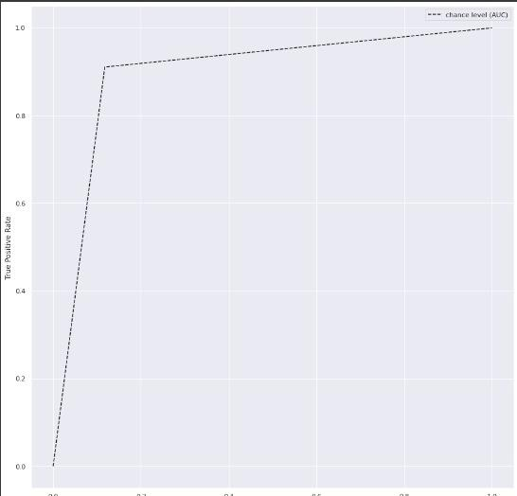
RANDOM FOREST CLASSIFIER
AREA UNDER THE CURVE

Slide 12
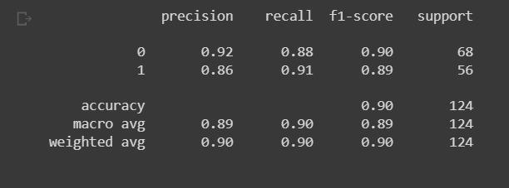
2. XGBOOST

Slide 13
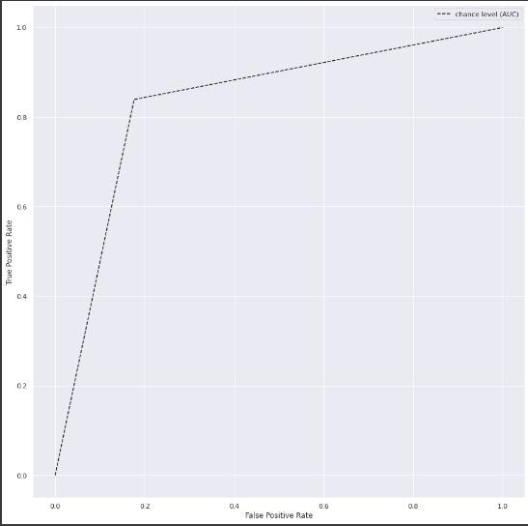
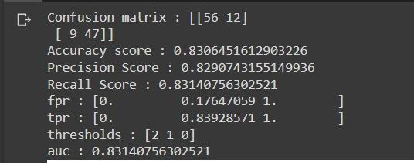
4. MULTILAYER PERCEPTRON
AREA UNDER THE CURVE

Slide 14
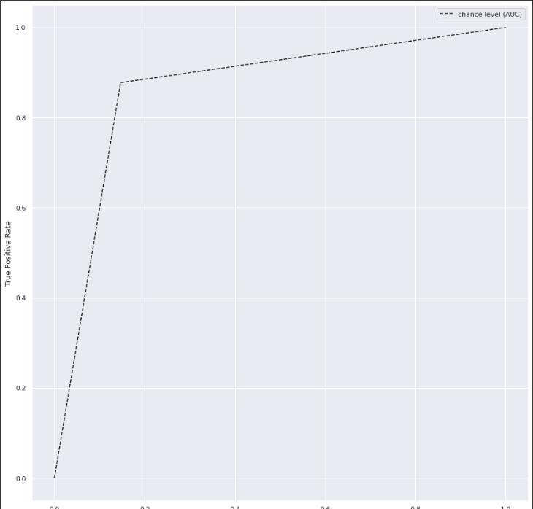
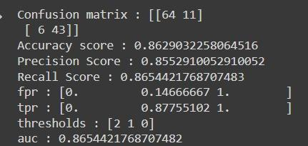
5. ADABOOST
AREA UNDER THE CURVE

Slide 15
RESULTS
S. NO | MODEL NAME | ACCURACY SCORE
1 | RANDOM FOREST CLASSIFIER | 0.8870
2 | XGBOOST | 0.8145
3 | STACKING CLASSIFIER | 0.919
4 | MULTI LAYER PERCEPTRON | 0.8314
5 | ADA BOOST | 0.8963

Slide 16
THANK YOU

